Slide 1
Assistive Technology and Worksite Assessments
Bill Field
National AgrAbility Project/Indiana AgrAbility Project
Breaking New Ground Resource Center, Purdue University

Slide 2
Overview
Principles for Providing Assistive Technology
Assistive Technology Assessment Steps
Assistive Technology Solutions
Liability
Agricultural Worksite Assessment Tool
Secondary Injury Assessment Tool

Slide 3
What is Assistive Technology? (AT)
Any item, piece of equipment, or product system, whether acquired commercially, modified, or customized, that is used to increase, maintain, or improve functional capabilities of individuals with disabilities. (Assistive Technology Act of 1998)

Slide 4
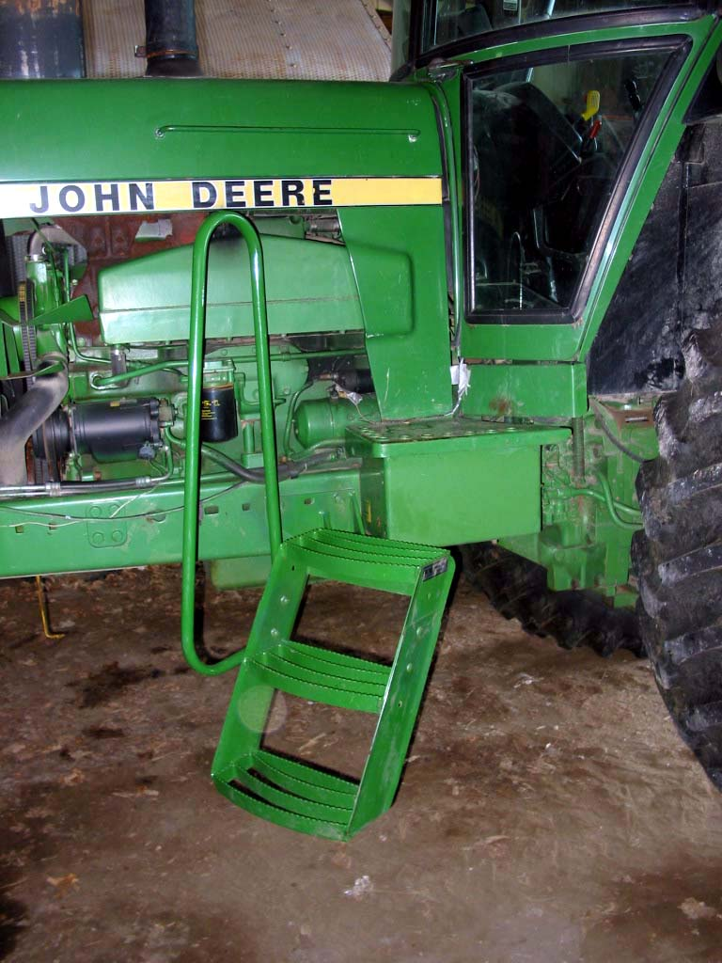
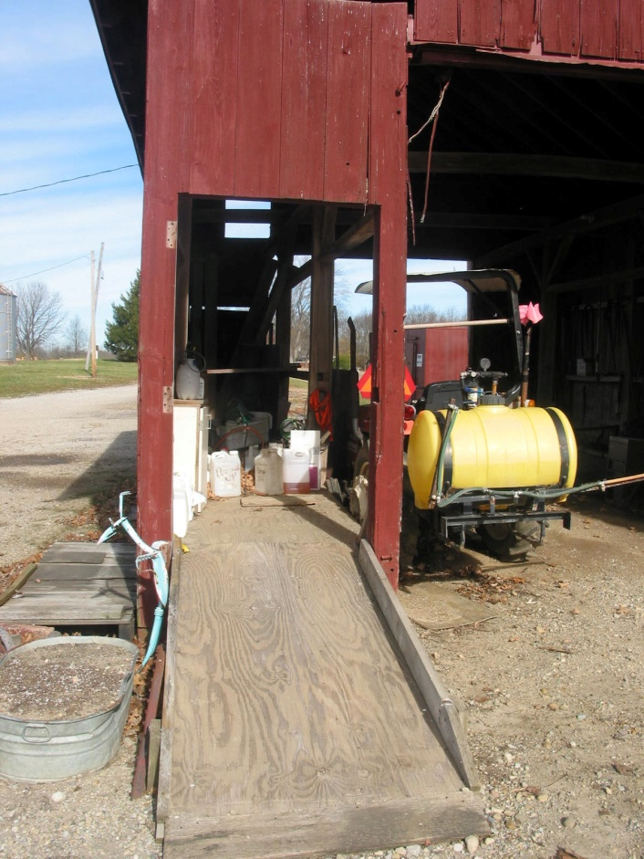
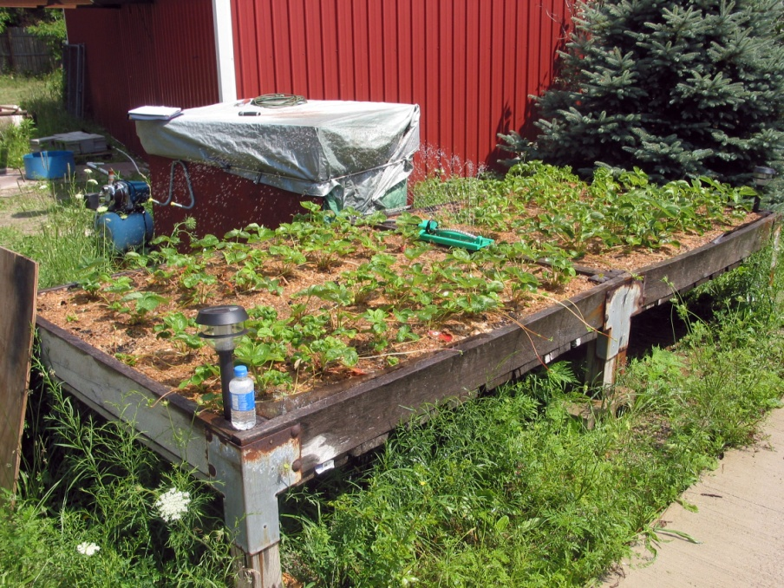

Slide 5
Principles for Providing AT
Keep the consumer and his goals as the central focus
Do no harm
Focus on functional abilities and potential
Offer simplest but still effective solution
Select from hierarchy of preferred interventions

Slide 6
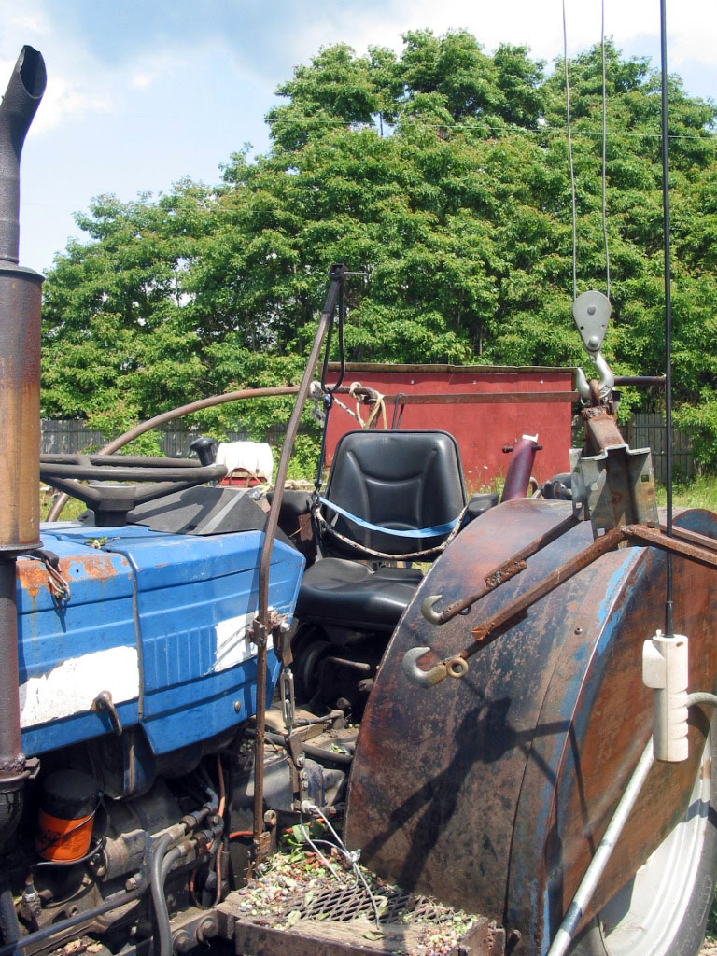
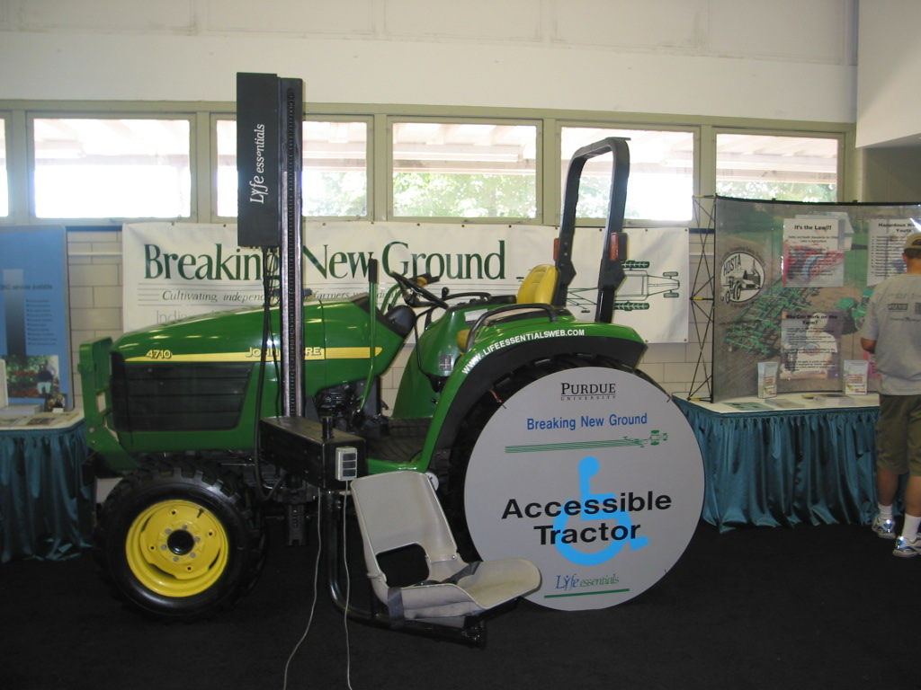

Slide 7
AT Assessment Steps
Phase A. Identify appropriate consumers for AT intervention.
Phase B. Perform an AT assessment.
Phase C. Develop a strategy and plan.
Phase D. Provide appropriate and timely implementation.
Phase E. Determine whether consumer goals and desired outcomes have been met.

Slide 8
The AT Assessment
Step 1. Gather information
- Interview the consumer and team
Step 2. Clarify the problems
- Interpret findings
- Integrate the information – consumer, task, technology, environment

Slide 9
The AT Assessment
Step 3. Produce a list of goals and desired outcomes
- Prioritize
- Should reflect consumer’s needs and preferences

Slide 10
The AT Assessment
Step 4. Identify and describe the generic attributes the solution will need.
- Develop several potential solutions
- Explore different options and strategies
- Perform simulations or trials of possible strategies

Slide 11
The AT Assessment
Step 4. Continued
- Consider both short and long term consequences.
-Consider impact of changes or new equipment on existing function and lifestyle.
-Assure compatibility with existing or anticipated equipment.

Slide 12
The AT Assessment
Step 5. List several intervention options that meet the desirable generic attribute
- Explore broad range of options
-Match desirable attributes to features of available equipment

Slide 13
The AT Assessment
- Consider using equipment of different levels of complexity (low tech to high tech, off-the-shelf to custom).
-Evaluate each for ability to match features desired and to meet goals.
- Recognize appropriate and improper use of equipment and advise accordingly

Slide 14
The AT Assessment
Step 6. Restate the preliminary goals.
- Revise goals that may have changed as a result of the information and analysis
- Assist to resolve trade-offs and prioritize goals
- List chosen goals

Slide 15
The AT Assessment
- Select a measurable outcome for each goal.
- Gain consensus on the selected goals from the consumer and team members

Slide 16
The AT Assessment
Step 7. Select the most desirable intervention option.
- Confirm the effectiveness of the option to meet the established goals.
- Gain consensus on the selected intervention.

Slide 17
The AT Assessment
Step 8. Make recommendations.
- Include specifics and details of new or modified equipment or technology
- Include training, follow-up, and other recommended services.

Slide 18
The AT Assessment
- Include other appropriate services –
- Surgery
- Job training
- Prosthetics, etc.
- Communicate the recommendations in a written report

Slide 19
Let’s Look at some AT for Agriculture
The Toolbox Assistive Technology Database
Available in print, CD, and online at www.agrability.org/toolbox
Many products are not specifically designed for PWD

Slide 20
Liability
Liability is all about managing risk.
You must be aware of both “professional” and “product” liability and/or risk.
Agriculture is inherently risky
Products and practices pose professional liability risks for AgrAbility staff

Slide 21
Other Resources
www.agrability.org/Resources
Plowshares technical articles
Assistive technology
Worksite and Vocational Issues

Slide 22
Liability
One of the best ways to manage or limit your liability or risk is to never practice outside your educational or “experiential” role.
Document, document, document

Slide 23
Liability
Three categories of product liability
Product design
Product manufacture or assembly
Product labeling – warnings and instructions

Slide 24
Liability
How to Protect Yourself
Professional liability insurance
Maintain proper and complete documentation
Follow the “safety hierarchy”
Introduction to Liability
http://fyi.uwex.edu/agrability/at/liability

Slide 25
Safety Hierarchy
“There are multiple layers or approaches for dealing with safety problems. The ones at the top of the safety hierarchy are best. You don’t have to exhaust all the possibilities at the top, but you need to do what you can do, to do the things at the top versus the things on the bottom of the safety hierarchy.”

Slide 26
Safety Hierarchy
Level 1 – Eliminate the hazard entirely
Level 2 – Add safeguarding technology
Level 3 – Use warning signs, labels, decals, etc.
Level 4 – Thoroughly train and instruct the operator/user to deal with hazards
Level 5 – Provide personal protective equipment

Slide 27
Home fabricated AT – Home Access Lift

Slide 28
Home-fabricated AT – Lift

Slide 29
Funding AT
AgrAbility cannot provide direct funding or equipment
State Vocational Rehabilitation (VR) Agencies
Veterans Administration (VA)
Non-profit organizations
Foundations
Local sources
FAQ

Slide 30
Worksite Assessment Tool
Conducting Agricultural Worksite Assessments: A User’s Guide for Professionals Assisting Farmers and Ranchers with Physical Disabilities

Slide 31
Worksite Assessment Tool
Who is it for?
Professionals
“Textbook” for new staff
Step-by-step approach
Designed to cover all the bases
“Playbook” for experienced staff
Improve assessment effectiveness
New angles, ideas

Slide 32
Printed Version Outline
Preface (Including Liability Statement)
Value of Assessments
Preparing for and Conducting Assessments
What is the Tool and How to Use It
Explanation of Tool ‘Questions’

Slide 33
Printed Version Outline
5. Client Records—Confidentiality, etc.
6. Examples of Completed Assessments
7. Related Resources
8. Appendix: Forms, Supplier List, Hotlines

Slide 34
Assessment Equipment
Camera
Clipboard
Tape measure
Angle finder
Fish scale
String level
Assessment tool
Wire brush
Circuit tester
Pliers
Magnifying glass
Utility Knife

Slide 35
Secondary Injury Assessment
Provide an evaluation tool for funding agencies to estimate safety of home-made AT
A training tool for rehab professionals
Secondary injury prevention
Help identify potential for injury
Provide suggestions for remedial action

Slide 36
Secondary Injury Assessment
Steps in the process
Reference sheets w/descriptions and pictures
Assessment example with worksheets filled out
Copy ready assessment sheets

Slide 37
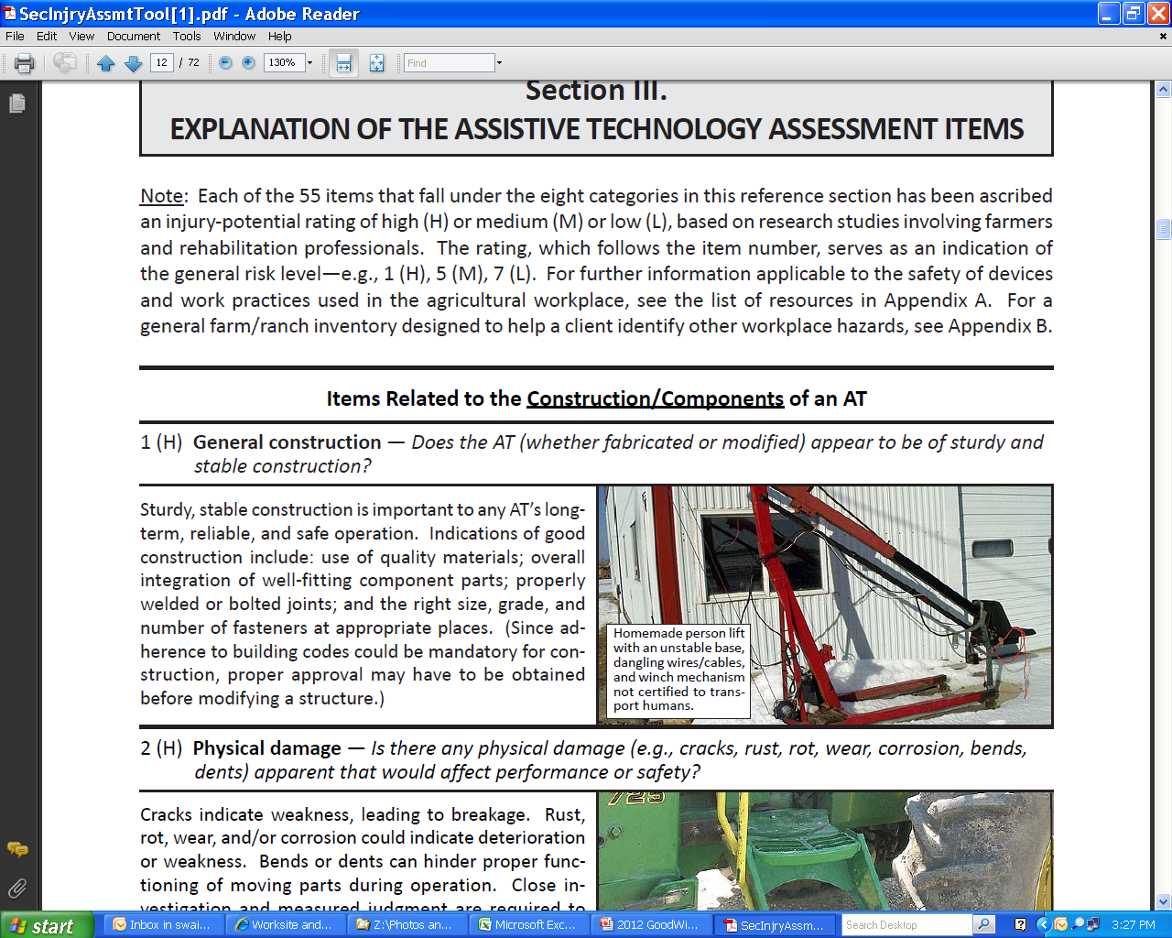

Slide 38
ADA Guidelines
When making recommendations, it is best to use the ADA Guidelines whenever possible.
http://www.ada.gov/

Slide 39
ADA Guidelines
Ramp slope: 1 inch rise per 12 inches of run
Pathways at least 36 inches wide
Reach up no more than 52 inches, sideways 24 inches, down 18 inches

Slide 40
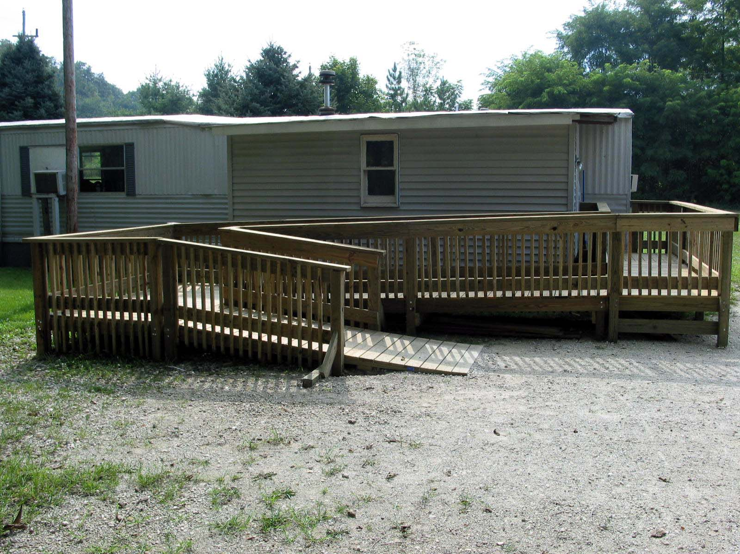

Slide 41
Product and Modification Solutions
Able Data: www.abledata.com
Public Assistive Technology Database – Georgia Tech – www.assistivetech.net

Slide 42
Questions?

